Slide 1

Development of Smart Solar Charge Controller on Wiznet W5500 IoT Platform
By
2111CS050009
2111CS050029
2111CS050041
2111CS050031
O. A. Varun
P. Lavanya
Y. Sathwik
M. Madhu
Under the Guidance of Dr. M.V.N. Srujan Manohar Assistant Professor
Department of Internet of Things School of Engineering
Malla Reddy University
Hyderabad, Telangana, India

Slide 2
ABSTRACT
The project represents a groundbreaking advancement in solar energy technology, drawing inspiration from nature's own efficiency mechanisms, particularly the heliotropic behavior of sunflowers. This project proposes the development and implementation of a solar energy system that dynamically adjusts the orientation of solar panels to track the sun's movement throughout the day, maximizing energy capture and efficiency. The system utilizes a biomimetic approach, mimicking the natural response of sunflowers to optimize sunlight exposure. Key components of the System include LDR sensors for real-time sun position tracking, actuators for panel orientation adjustments, and a central control unit to manage system operations. This project aims to address the limitations of traditional fixed solar panel systems, which are unable to adapt to changing sunlight angles throughout the day. The proposed system has been extended to confess the efficient “MPPT” based solar charge controller and its riposte by employing web servers and the Laptops/cell phones. The utensil has been used is “W5500”, the web server which will be gathered together and combine on W5500 module is engaged as an IoT platform. As web servers are unlimited of platforms, they can be endorsed in cell phones/laptop which is urged by relays and sequentially web servers assess the solar charge controllers through W5500 module. The proposed system is competent of enlightening the battery charging state under dissimilar weather, whenever required and can be additionally ameliorated to track other appliances. There are different modules employed in solar charge controller which fabricated it as an IoT based device; like WIZNET (W5500),Arduino nano(Atmega 328p), Solar Panels, Servo’s which is Palpably cost effective and also low energy utilization.

Slide 3
1. Introduction
Problem Definition & Description
Problem specification & description
Develop a smart solar energy harvesting system that dynamically adjusts solar panel orientation to track the sun's movement throughout the day, maximizing energy capture and efficiency. Implement a robust hardware setup using LDR sensors, servo motors, microcontroller, and charge controller. Enable data transmission to an IoT platform for monitoring and analysis of energy generation and system performance.
Objectives of the Project
Aim of the project
To Design a solar energy system capable of dynamically adjusting solar panel orientation based on real-time sun position. Following the best efficient Technique of energy gathering i.e MPPT designed ourselves. Enable data transmission to an IoT platform for monitoring and analysis of energy generation and system performance. Optimize system efficiency and reliability through iterative testing and refinement.
Tasks and deliverables
A functional smart solar energy harvesting system capable of dynamically adjusting solar panel orientation to track the sun's movement. Real-time monitoring and analysis of energy generation data on the IoT platform. Increased energy capture and efficiency compared to traditional fixed solar panel systems. Potential for scalability and adaptability to other renewable energy systems and IoT applications.

Slide 4
1. Introduction
1.3 Scope of the project
Determining goals
Improve upon the limitations of traditional fixed solar panel systems by providing a scalable and adaptable solution. Demonstrate the potential for increased energy capture and efficiency compared to traditional systems. Contribute to advancements in renewable energy technology and IoT applications. Provide a cost-effective and sustainable solution for remote power generation and monitoring in various environmental conditions. Ensure compatibility and interoperability of components for seamless operation and scalability. Optimize system performance and reliability under varying weather conditions to ensure continuous energy generation.
Data & Constrains
Sun Position Data, Solar Panel Output Data, Environmental Data, System Status Data, Mechanical Constraints, Power Constraints, Size and Weight Constraints , Environmental Constraints, Cost Constraints, Regulatory Constraints, Reliability Constraints, Communication Constraints, Scalability Constraints, Safety Constraints, Maintenance Constraints.
Workflow management strategies
Define project goals, scope, and timeline. Design hardware architecture and select components based on project requirements. Develop software algorithms for sun position tracking, servo motor control, and data transmission. Prototype hardware setup and test individual components for compatibility and functionality. Integrate hardware and software components into the complete system setup. Configure data transmission to the IoT platform for real-time monitoring and analysis.

Slide 5
2. System Analysis
Existing System
Background & Literature Survey
The work of S. Gupta et al. [1] presented a case study of a solar tracking system deployed in a rural area, highlighting its
impact on improving energy access and sustainability for off-grid communities.
A study by A. Akilandeswari et al. [2] proposed a solar tracking system using Arduino microcontroller and servo motors to adjust panel orientation based on sun position data obtained from an LDR sensor.
Limitations of Existing System
Reference [1]The study not address broader challenges such as technology adoption barriers, maintenance issues, or long-term sustainability.
Reference [2] The study not address challenges related to hardware compatibility, reliability, scalability, or performance
optimization
Proposed System
Advantages of Proposed System
Optimized Energy Capture: system maximizes energy capture and efficiency.
Improved Performance in Variable Conditions.
Remote Monitoring and Control.
Scalability and Adaptability.

Slide 6
2. System Analysis
2.3 Software & Hardware Requirements
Software Requirements
Arduino IDE, Installed Libraries(Servo, LCD, Ethernet)
Hardware Requirements
Arduino Nano’s, Buck converter, LCD display, Solar Panels(6v – 70mAh), LDR’s, Wiznet W5500, Servo Motors, DC motor, L293D Motor Driver, Battery (Li-on / Lead Acid), Current Sensor, Mosfet’s, Resistors.
2.4 Feasibility Study
Technical Feasibility
The technical feasibility of the proposed Smart Solar Charge Controller using the Wiznet W5500 IoT platform is evident due to the availability of compatible components such as LDR sensors, actuators, and Arduino microcontrollers. Integration with the Wiznet W5500 module enables IoT connectivity, facilitating remote monitoring and control.
Robustness & Reliability
Smart Solar Charge Controller stem from its utilization of quality components such as LDR sensors, actuators, and the Wiznet W5500 IoT platform, ensuring stable operation. Rigorous testing under diverse environmental conditions ensures resilience against fluctuations and faults, enhancing system durability.
Economic Feasibility
The economic feasibility of the Smart Solar Charge Controller is promising due to its potential for significant long-term cost savings through improved energy capture and efficiency. Initial investment costs are offset by reduced electricity bills over the system's lifespan.

Slide 7
3. Architectural Design
3.1 Module Design:
3.1.1 Arduino Nano
This module represents the Arduino Nano microcontroller board, which serves as the main controller for the project. It includes components such as Light Dependent Resistors (LDRs) and Servo motors. LDRs sense the light intensity, and Servos adjust the position of the solar panels based on the light intensity detected.
3.1.2 ESP32 Module:
This module represents the ESP32 microcontroller board, which is responsible for monitoring the load state, battery voltage, and hosting a web page to display results.
It interfaces with the battery, load (via USB Booster), and the internet(W5500) to host a web page.
3.1.3 Internet Module W5500:
This module represents the internet connection via TCP/IP stack, this module represents the Wiznet W5500 Ethernet controller module, which provides internet connectivity to the ESP32.It enables the ESP32 to communicate over the internet, allowing it to host a web page to display system information.
3.1.4 Solar Panel Module:
This module represents the solar panels used to generate electricity.
The output of the solar panels is regulated by an MPPT (Maximum Power Point Tracking) module (MPPT CN3791) to optimize power transfer.

Slide 8
3. Architectural Design
3.1.5 Charging Module Module:
This module represents the battery charging module.
It regulates the charging of the battery using the power generated by the solar panels, ensuring safe and efficient charging.
3.1.6 Battery Module:
This module represents the battery used to store the solar energy.
The battery is charged by the charging module and provides power to the load when needed.
3.1.7 USB Booster 5v Module:
This module represents the USB booster that provides a 5V output.
It is used to power the load or other devices requiring a 5V power supply.

Slide 9
3.2 Method and Algorithm Design :
3.2.1 Light Intensity Sensing Method:
Utilize Light Dependent Resistors (LDRs) to sense the intensity of light.
Read analog values from LDRs using analog pins of the Arduino Nano.
Convert analog readings to digital values representing light intensity levels.
3.2.2 Solar Panel Adjustment Method:
Employ Servo motors to adjust the position of solar panels based on light intensity readings.
Calculate the required angle adjustment based on the difference between current and desired light intensity levels.
Send control signals to Servo motors to rotate them to the desired angles.
3.2.3 Battery Charging Method:
Utilize Maximum Power Point Tracking (MPPT) algorithm to regulate charging of the battery.
MPPT algorithms continuously track the maximum power point of the solar panels by adjusting the operating point of the charging circuit.
Optimize power transfer efficiency from the solar panels to the battery by dynamically adjusting the voltage and current.
3.2.4 Load Control Method:
Monitor load state using the ESP32 microcontroller.
Implement a control mechanism to switch the load on or off based on predetermined conditions such as battery voltage or user-defined thresholds.
Utilize digital output pins of the ESP32 to control the load state.
3.2.5 Web Page Hosting Method:
Implement a web server on the ESP32 to host a web page for displaying system information.
Use HTTP protocol to serve static or dynamically generated web pages.
Provide endpoints for accessing real-time data such as load state, battery voltage, and system status.

Slide 10
3.2.6 Maximum Power Point Tracking (MPPT) Algorithm:
Perturb and Observe (P&O) algorithm: Incrementally perturb the operating point of the solar panels and observe the change in power output.
Incremental Conductance (IncCond) algorithm: Analyze the derivative of the power-voltage curve to track the maximum power point.
Fractional Open-Circuit Voltage (FOCV) algorithm: Utilize open-circuit voltage measurements to estimate the maximum power point.
1. Initialize variables:
- V_prev: Previous voltage
- P_prev: Previous power
- step_size: Initial step size (e.g., 0.1V)
2. Loop:
a. Measure the voltage (V) and current (I) from the solar panels.
b. Calculate the power (P = V * I).
c. Calculate the change in power (delta_P = P - P_prev).
3. If delta_P > 0:
- Increment the voltage by step_size (V_new = V_prev + step_size).
Else if delta_P < 0:
- Decrement the voltage by step_size (V_new = V_prev - step_size).
Else:
- Maintain the current voltage (V_new = V_prev).
4. Set the new voltage as the operating voltage (V_prev = V_new).
5. Repeat the loop.

Slide 11
3.2.7 Servo Control Algorithm:
Proportional-Integral-Derivative (PID) control algorithm: Adjust servo motor position based on the difference between desired and current positions.
Define proportional, integral, and derivative terms to calculate the control signal for precise and stable servo motor movement.
3.2.8 Load State Monitoring Algorithm:
Simple threshold-based algorithm: Monitor battery voltage and load current to determine whether the load should be turned on or off.
Set predefined voltage thresholds for load activation and deactivation.
3.2.9 Web Page Generation Algorithm:
Use HTML, CSS, and JavaScript for creating the user interface of the web page.
Dynamically update the content of the web page with real-time data retrieved from the ESP32 microcontroller.

Slide 12
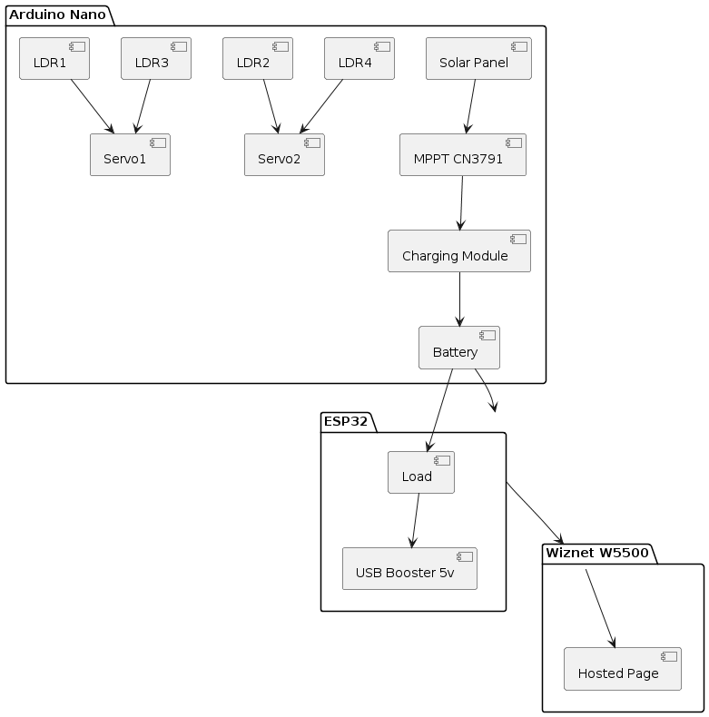
3.3 Project Architecture
3.3.1 Architecture Diagram
The architecture of a smart solar charge controller system. It comprises an Arduino Nano controlling Light Dependent Resistors (LDRs) and Servo motors to adjust solar panels based on light intensity. Solar energy is regulated by an MPPT CN3791 module before charging a battery through a charging module. An ESP32 monitors load state and battery voltage, hosting a web page via a Wiznet W5500 module for displaying system information. The battery powers a load through a USB Booster 5V module. This integrated system optimizes solar power generation, storage, and distribution, providing an efficient and sustainable energy solution.

Slide 13
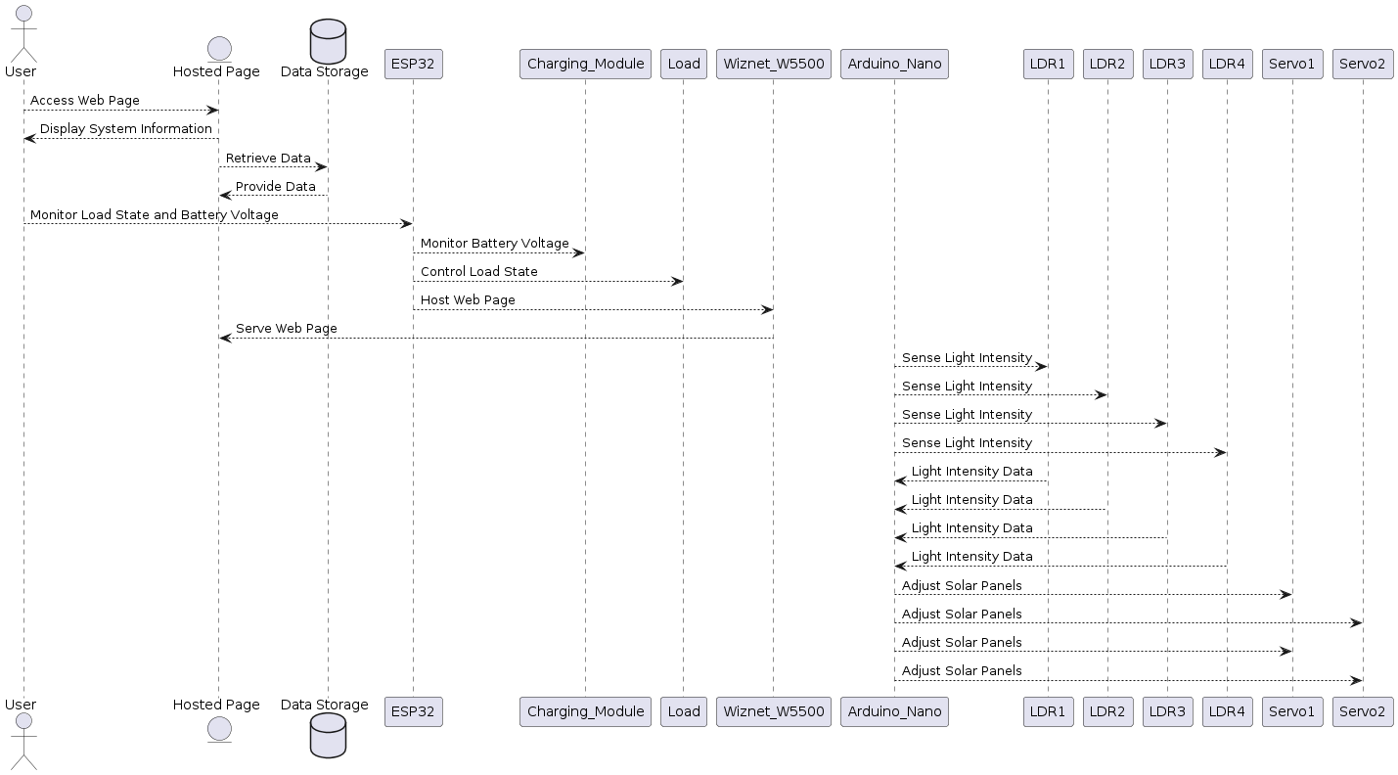
3.3.2 Data Flow Diagram

Slide 14
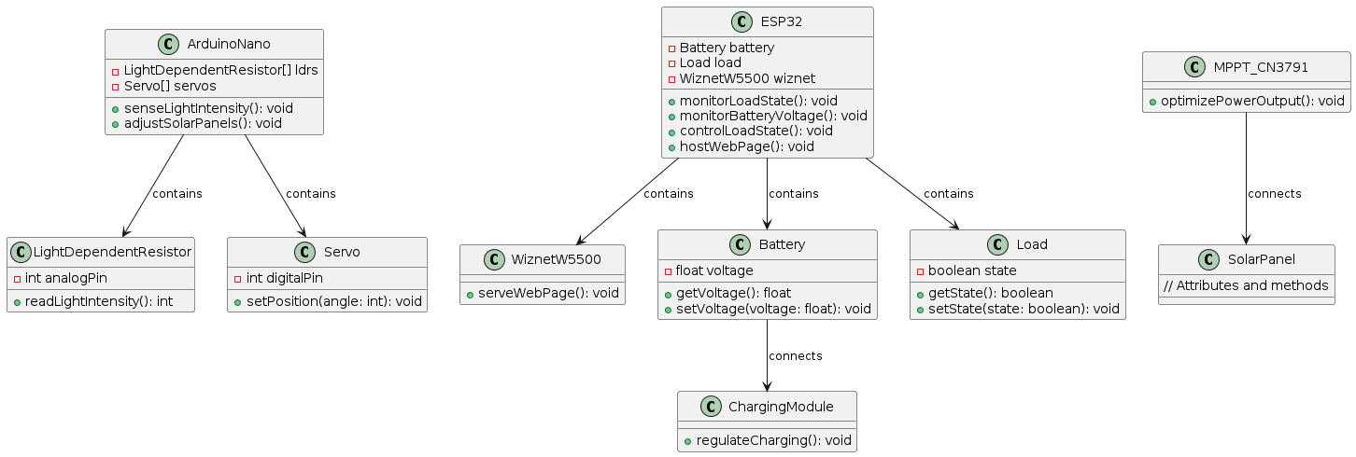
3.3.3 Class Diagram

Slide 15
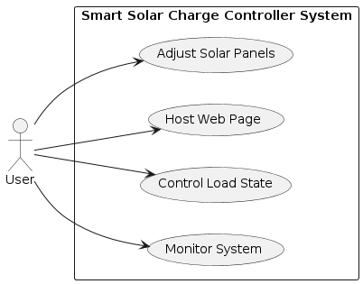
3.3.4 Use-Case Diagram

Slide 16
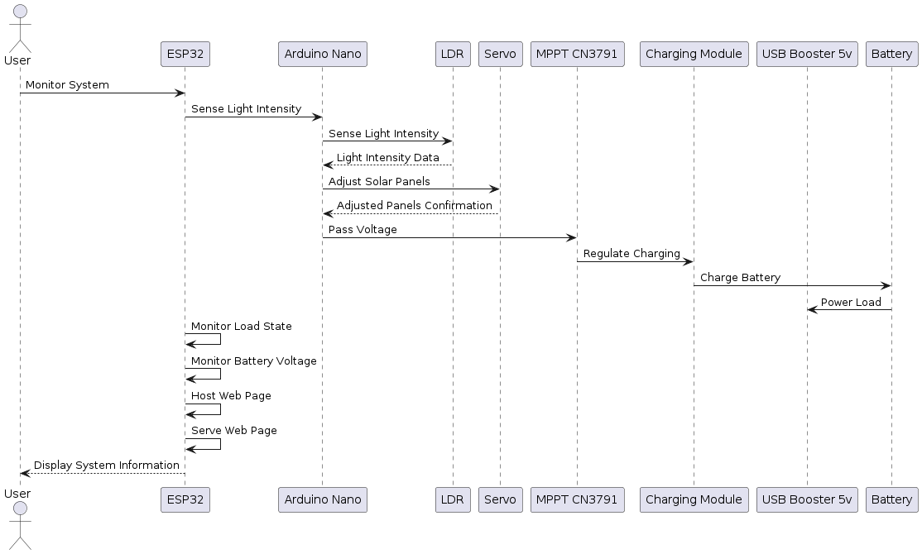
3.3.5 Sequence Diagram

Slide 17
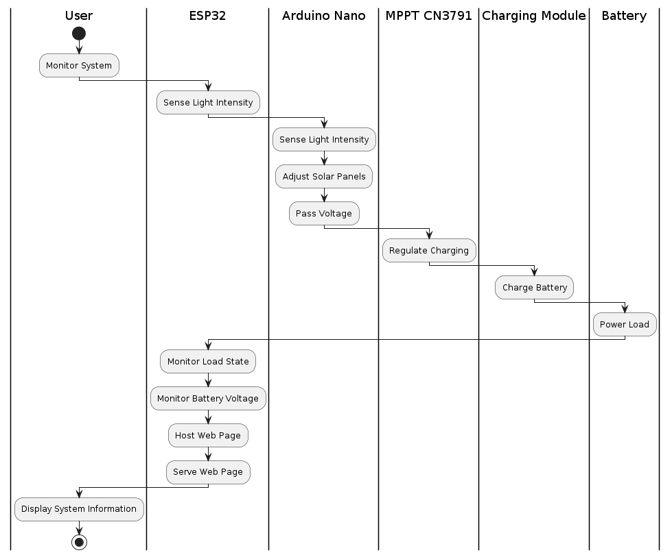
3.3.6 Activity Diagram

Slide 18
4. Implementation and Testing
4.1 Coding Block 1
if(rRDL1<max3 && rRDL2<max3)
{
if(ser1<140)
ser1+=1;
myservo1.write(ser1);
}
if(rRDL3<max3 && rRDL4<max3)
{
if(ser1>0)
ser1-=1;
myservo1.write(ser1);
}
if(rRDL2<max3 && rRDL3<max3)
{
Serial.println("servo2 +" + String(ser2));
if(ser2<180)
ser2+=1;
myservo2.write(ser2);
}
if(rRDL1<max3 && rRDL4<max3)
{
Serial.println("servo2 -" + String(ser2));
if(ser2>0)
ser2-=1;
myservo2.write(ser2);
}
delay(15);
}
#include <Servo.h>
Servo myservo1, myservo2;
int LDR1 = A0, LDR2 = A1, LDR3 = A2, LDR4 = A3;
int rRDL1 = 0, rRDL2 = 0, rRDL3 = 0, rRDL4 = 0;
int max1=0, max2=0, max3=0;
int ser1 = 80, ser2=0;
void setup() {
myservo1.attach(9);
myservo2.attach(8);
Serial.begin(9600);
myservo1.write(ser1);
myservo2.write(100);
}
void loop() {
rRDL1 = analogRead(LDR1) / 100;
rRDL2 = analogRead(LDR2) / 100;
rRDL3 = analogRead(LDR3) / 100;
rRDL4 = analogRead(LDR4) / 100;
max1 = max(rRDL1, rRDL2);
max2 = max(rRDL3, rRDL4);
max3 = max(max1, max2);

Slide 19
4.Implementation and Testing
4.2 Coding Block 2
void loop() {
float batteryVoltage = ina219.getBusVoltage_V();
bool loadStatus = digitalRead(LOAD_PIN);
webpage = "<html>
<head><title>ESP32 Web Server</title></head>
<body>"; webpage += "<h1>ESP32 Web Server</h1>"; webpage += "<p>Battery Voltage: " + String(batteryVoltage) + " V</p>"; webpage += "<p>Load Status: " + String(loadStatus ? "ON" : "OFF") + "</p>"; webpage += "</body>
</html>";
Serial.print("Battery Voltage: ");
Serial.print(batteryVoltage);
Serial.println(" V");
Serial.print("Load Status: ");
Serial.println(loadStatus ? "ON" : "OFF");
client.println("HTTP/1.1 200 OK");
client.println("Content-Type: text/html");
client.println("Connection: close");
client.print("Content-Length: ");
client.println(webpage.length());
client.println(); client.print(webpage);
digitalWrite(LED_PIN, HIGH);
delay(500); digitalWrite(LED_PIN, LOW);
delay(500);
delay(1000);
client.stop();
}
#include <SPI.h>
#include <Ethernet.h>
#include <Wire.h>
#include <Adafruit_INA219.h>
#define W5500_CS 10
#define W5500_RST 9
#define W5500_INT 2
#define INA219_I2C_ADDRESS 0x40
#define LED_PIN 13 (INA219_I2C_ADDRESS);
void setup(){
Serial.begin(115200);
Ethernet.begin(mac);
delay(1000); Ethernet.init(W5500_CS, W5500_RST,W5500_INT);
if (!ina219.begin()) {
Serial.println("Failed to initialize INA219 sensor!");
while (1); } ina219.setCalibration_16V_400mA(); pinMode(LED_PIN, OUTPUT);
}

Slide 20
4.3 Testing
Code to Test LDR Values.
#define LDRpin1 A0
#define LDRpin2 A1
#define LDRpin3 A2
#define LDRpin4 A3
int LDRValue1 = 0;
int LDRValue2 = 0;
int LDRValue3 = 0;
int LDRValue4 = 0;
void setup()
{
Serial.begin(9600);
}
void loop()
{
LDRValue1 = analogRead(LDRpin1);
LDRValue2 = analogRead(LDRpin2);
LDRValue3 = analogRead(LDRpin3);
LDRValue4 = analogRead(LDRpin4);
Serial.print("LDR1: ");
Serial.print(LDRValue1);
Serial.print("\tLDR2: ");
Serial.print(LDRValue2);
Serial.print("\tLDR3: ");
Serial.print(LDRValue3);
Serial.print("\tLDR4: ");
Serial.println(LDRValue4);
delay(200); // Adjust delay as needed
}

Slide 21
Thank you
Queries?

